Slide 1
Module 4: Editing text
4: Editing Text
5: Working with Bash
6: Customising the Bash Environment

Slide 2
Contents
Evolution of text editors
Using vi/vim
Nano
Notes:
Editing text is an essential skill we will learn about vi and nano in this chapter.

Slide 3
Evolution of text editors (Reference)

Slide 4





Evolution of Editors – from qed to vim
The qed editor (1966)
“Quick Editor” developed at Berkeley
Designed for teleprinters (no screen)
Foundation for UNIX editors
The ed editor (1969)
First standard UNIX text editor
Line-based (not full screen)
Very minimal visual feedback
The ex editor (1976)
Extended version of ed
Added more powerful commands
Introduced visual mode (visual)
The vi editor (1979)
Full-screen visual editor
Built on ex visual mode
Became standard UNIX editor
The vim editor (1991)
“Vi Improved”
Adds features such as syntax highlighting, undo, plugins
Widely used today
From line-based editing → full-screen editing → modern extensible editor
Notes:
qed (Quick Editor), developed in the mid-1960s at Berkeley, was designed for teleprinters rather than screens. In 1969, Ken Thompson, one of the creators of Unix at Bell Labs, developed ed, inspired by qed, adding support for regular expressions but keeping a line-based interface with minimal visual feedback.
In 1976, Bill Joy extended this with ex, which added more powerful commands but was still largely line-oriented. This evolved into vi (1979), a full-screen “visual” editor designed for video terminals, which became the standard Unix editor.
In 1991, Bram Moolenaar created vim (“Vi Improved”), inspired partly by the Atari ST editor Stevie. Vim added features such as syntax highlighting, split windows, plugins and extensive help, and remains widely used today.
Learning vim is often seen as a rite of passage for Linux users, although simpler alternatives like nano (GNU, 1999) are also available.

Slide 5
Using vi / vim

Slide 6
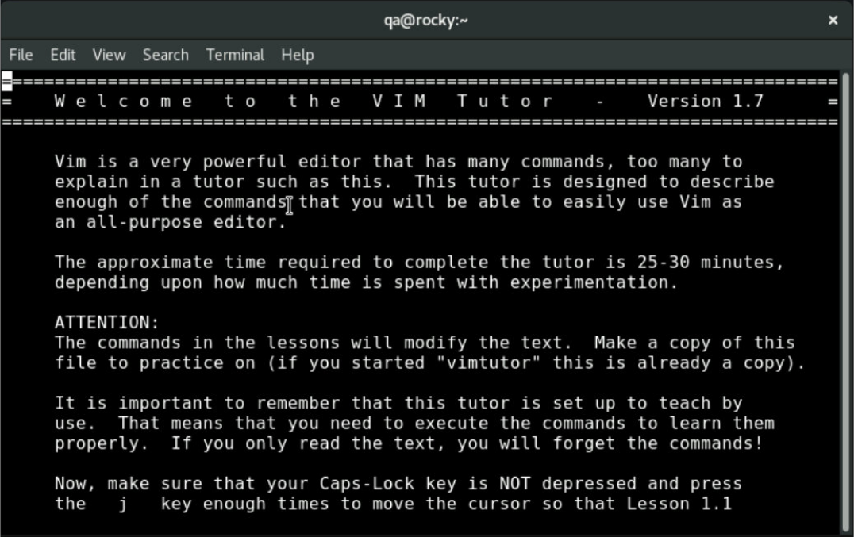
Why use vi and vim?
Why use vi and vim?
vim (Vi Improved) is the modern version of vi, a lightweight terminal-based editor
Why learn vim?
Available on almost every Linux/Unix system
Fast and highly efficient once learned
Essential for server administration and remote work
Ways to learn vim:
Interactive learning: https://vim-adventures.com/
Built-in tutorial:
$ vimtutor
It feels strange at first… but becomes very fast
Notes:
The vi editor is a classic text editor available on almost all Unix and Linux systems. It is lightweight and runs entirely in the terminal, making it especially useful when working on remote servers where graphical tools are not available. Most modern systems actually provide vim, which stands for “Vi Improved,” and includes many enhancements over the original vi, while maintaining the same core commands and behaviour.
One of the key reasons to learn Vim is its availability and efficiency. Once you become familiar with its modal editing style, it allows you to navigate and edit text very quickly without needing a mouse. This makes it an essential tool for system administrators and anyone working regularly in a Linux environment.
To start using Vim, you simply run vi or vim followed by a filename. If the file exists, it will be opened for editing; if not, a new file will be created. You can also use the view command to open a file in read-only mode.

Slide 7
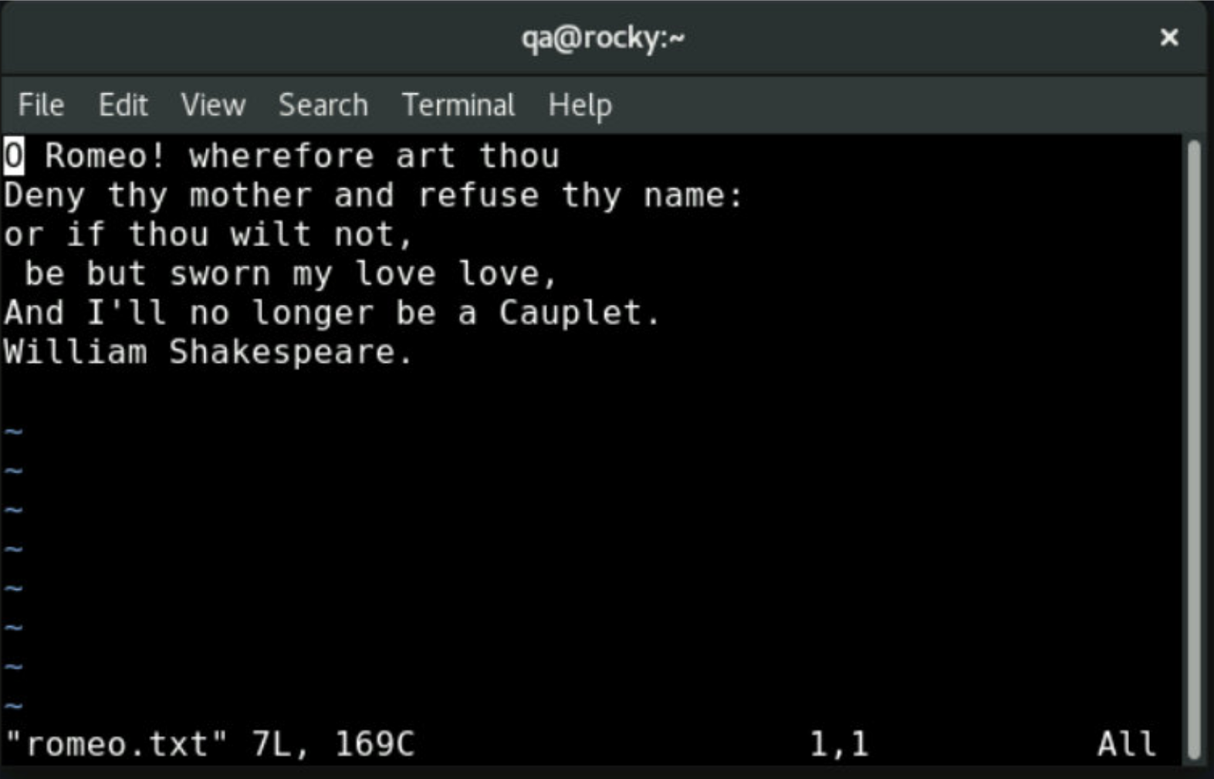
Opening Files in Vim
Open and edit an existing file:
Open and edit a new file:
Open vim without a file:
Recover last file edited:
Open and view a file (readonly):
Open at end of file:
$ vim romeo.txt
$ vim newfile
$ vim
$ vim –r
$ view romeo.txt
$ view + /etc/passwd
Notes:
Vim can be started in several ways depending on what you want to do. The most common approach is to open an existing file by specifying its name, for example vim romeo.txt. If the file exists, it will be opened for editing. If it does not exist, Vim will create a new file with that name when you save it.
You can also create a new file directly by providing a filename that does not yet exist, such as vim newfile. Vim does not distinguish between opening and creating - it simply opens a buffer and associates it with the filename.
If you run vim on its own without specifying a file, Vim opens an empty buffer. This can be useful if you want to start typing or paste content before deciding on a filename.
Vim also provides a recovery option using vim -r, which attempts to recover a file from a previous session, typically after a crash. This uses swap files created automatically by Vim to restore unsaved changes. To open a file in read-only mode, you can use the view command, for example view romeo.txt. This allows you to safely inspect a file without accidentally modifying it.
Finally, you can open a file and position the cursor immediately at the end using the + option, as shown in the example. This is useful when working with log files or when you want to jump straight to the most recent content.

Slide 8
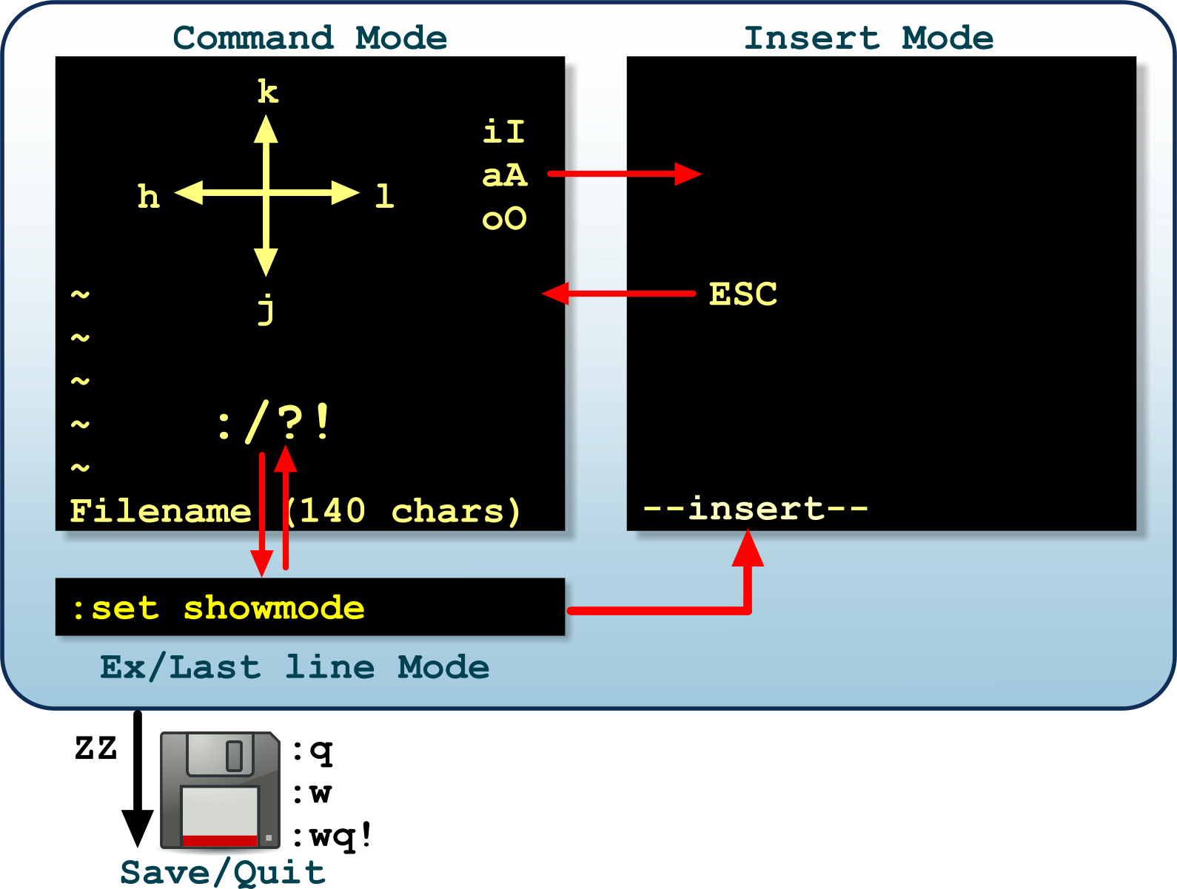
Vim has 3 Modes
Vim is a modal editor
Keys behave differently depending on mode
Modes
Command mode: navigate and issue commands
Insert mode: enter and edit text
Ex/Last-line mode: save quit, search and run commands
Notes:
Vim is known as a modal editor, which means the keyboard behaves differently depending on the current mode.
The default mode when you open Vim is Command mode. In this mode, the keyboard is used for navigation and editing commands rather than inserting text. For example, keys such as h, j, k, and l are used to move the cursor, and other keys perform actions like deleting or changing text.
To start typing text, you must switch to Insert mode. This is done using commands such as i, a, or o. Once in Insert mode, Vim behaves more like a traditional text editor, allowing you to enter and modify text. To leave Insert mode and return to Command mode, press the ESC key. This is one of the most important keys to remember when using Vim.
The third mode is Ex mode, also known as last-line mode. This is accessed from Command mode by typing “:” - Ex mode is used to enter commands such as saving, quitting, and searching within a file. For example, :w saves changes, :q quits, and :wq saves and exits.
A good habit when working with Vim is to return to Command mode by pressing ESC before issuing any commands. If you are ever unsure which mode you are in, pressing ESC is a safe way to get back to a known state.

Slide 9
Command Mode and Structure
Command Mode:
Default mode when Vim opens
Used for navigation and commands
Commands are keystrokes, not typed text
Press ESC to return to command mode
Command Structure:
Many commands follow this pattern:
Example:
10 -> repeat 10 times
d -> delete
w -> word
[count][command][navigation]
10dw
Press <ESC> often – it gets you back to safety
Notes:
Vim opens in Command Mode, which is the default working mode. In this mode, the keyboard is used to issue commands and move around the file, rather than to type text. This can feel unusual at first, but it allows for very fast editing once you get used to it.
Commands in Vim are keystrokes, not typed words, and many follow a simple structure: [count][command][motion]
This means you can combine actions with movement.
For example:
d = delete
w = move by word
So, dw deletes one word and 10dw deletes 10 words. The number (count) simply repeats the command.
Navigation keystrokes (such as w, b, 0, $) define the scope of the command, in Vim documentation these are often called motions but are often just referred to as navigation by practitioners.
Some commands will switch you into Insert Mode, but you can always return safely to Command Mode by pressing ESC. A good habit is to press ESC regularly if you’re unsure - it gets you back to a known state. If this has been mentioned before – its because it’s a good tip!

Slide 10
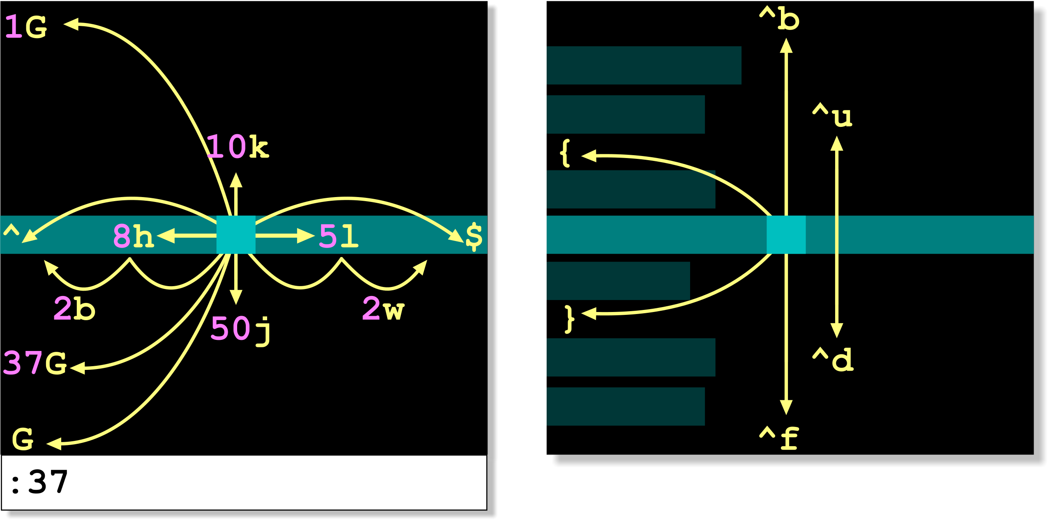
Navigation
Your instructor will guide you through these actions:
Notes:
This slide visualises how Vim movement commands work together and how they can be combined with numbers to move efficiently through a file. Rather than moving one character or line at a time, you can prefix commands with a number, for example, 10k moves up ten lines and 5l moves right five characters. Similarly, w and b move between words and can also be combined with numbers for faster navigation.
Commands such as 0 and $ move to the beginning and end of a line, while G, gg, and nG allow quick movement to specific locations within the file. The diagram also introduces paragraph movement using { and }, and screen-based navigation using Ctrl commands like Ctrl+F and Ctrl+B.
The key idea is that Vim navigation is composable - you build more powerful movements by combining simple commands with counts. This is what makes Vim fast once you become comfortable with it.

Slide 11
Navigation - Keystrokes
Basic movements (command mode):
Line navigation:
Screen movement:
Keys | Action
h | Left cursor move
l | Right cursor move
k | Up cursor move
j | Down cursor move
w | Forward to start of next word
b | Back to start of word
e | Forward to end of word
Keys | Action
0 | Start of line
$ | End of line
gg | Go to first line
G | Go to last line
nG | Go to line n
{ | Previous paragraph
} | Next paragraph
Key | Action
Ctrl+F | Forward one screen
Ctrl+B | Back one screen
Ctrl+D | Down half screen
Ctrl+U | Up half screen
Ctrl+G | Show position/status
Ctrl+L | Redraw screen
Notes:
In Vim, navigation is performed primarily in normal mode using keyboard shortcuts rather than the mouse or arrow keys. The keys h, j, k, and l are used to move left, down, up, and right respectively, and form the foundation of efficient movement within a file. Additional shortcuts such as w, b, and e allow movement between words, making it quick to navigate text without switching modes.
For moving within a line or across a file, Vim provides powerful shortcuts. Pressing 0 moves to the start of the current line, while $ moves to the end. The command gg jumps to the beginning of the file, and G moves to the end. You can also jump directly to a specific line using nG, where n is the line number. Paragraph navigation is handled using { and }, which move to the previous and next blocks of text.
To move through larger sections of a file, screen-based navigation commands are used. Ctrl+F and Ctrl+B move forward and backward by a full screen, while Ctrl+D and Ctrl+U scroll by half a screen. The command Ctrl+G displays the current file position and status information, and Ctrl+L refreshes the screen if the display becomes cluttered. Mastering these navigation commands allows users to work quickly and efficiently within Vim, especially when editing large files.

Slide 12
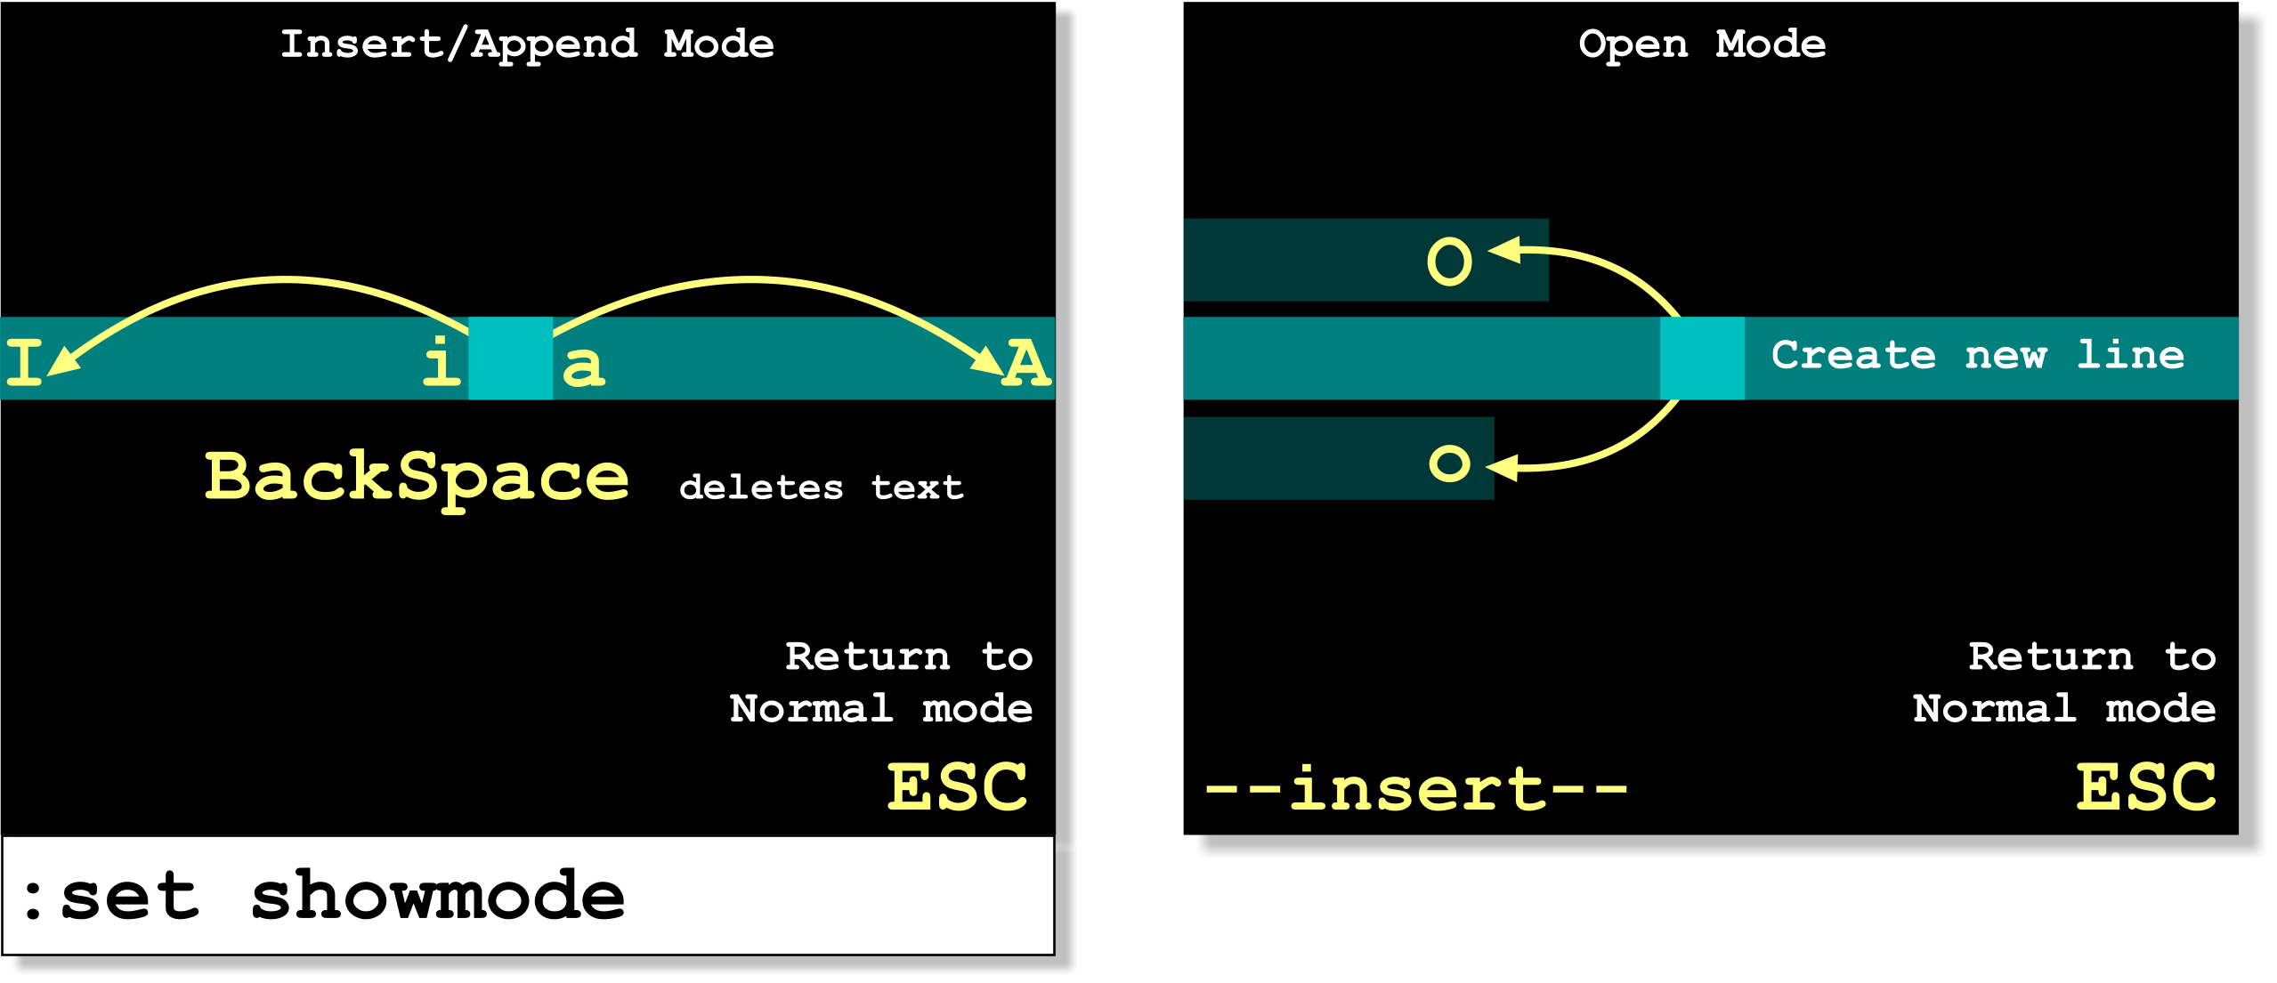
Insert, Append and Open Mode
Your instructor will guide you through these actions:
Notes:
In Vim, text editing happens in insert mode, which is where you can type and modify content in a similar way to a standard text editor. You enter insert mode from normal mode using commands such as i (insert before the cursor), a (append after the cursor), I (insert at the start of the line), and A (append at the end of the line). These commands determine exactly where your text will be inserted relative to the cursor.
You can also create new lines and begin typing immediately using o (open a new line below) and O (open a new line above). These are particularly useful when adding new content without manually moving the cursor to a new line first.
While in insert mode, you can type freely and use keys such as Backspace to delete text. However, it’s important to remember that Vim has different modes, and to return to normal mode you must press ESC. Normal mode is where navigation and command-based editing take place, so switching between modes becomes a key part of working efficiently in Vim.
The key idea is that Vim separates navigation and editing into different modes. Insert mode is for typing, while normal mode is for controlling and moving around the file. Getting comfortable switching between these modes is essential to becoming effective with Vim.

Slide 13
Insert, Append and Open Mode - keystrokes
Each of these commands enters Insert mode;
Type text until <ESC> (or Ctrl-[) is pressed to return to Normal mode
In Insert mode, Backspace and Delete behave normally
To display current mode:
Key | Action
i | Insert before cursor
a | Append after cursor
I | Insert at start of line
A | Append at end of line
O | Open new line above this one
o | Open new line below this one
: set showmode
Notes:
Insert mode is where text is entered and edited in Vim. You enter this mode using commands such as i and a, which insert text before or after the cursor, or I and A, which move to the beginning or end of the line before inserting. The commands o and O are particularly useful, as they create a new line below or above the current line and immediately place you into insert mode ready to type.
While in insert mode, the editor behaves much like a standard text editor, allowing you to type freely and use keys such as Backspace and Delete. However, it is important to remember that you must press ESC to return to normal mode before using navigation or command-based editing features.
For beginners, it can sometimes be unclear which mode Vim is currently in. The :set showmode command displays the current mode at the bottom of the screen, which can be helpful while learning. Over time, switching between normal and insert mode becomes second nature and is a key part of working efficiently in Vim.

Slide 14
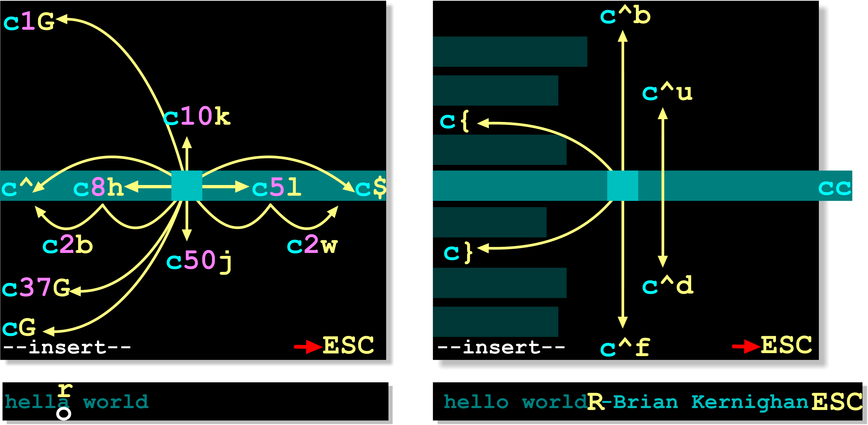
Changing Text
Your instructor will guide you through these actions:
c<navigation>
Notes:
In Vim, changing text is done using the c (change) command, which combines deletion and insertion in a single step. When you use a change command, Vim removes the specified text and immediately switches to insert mode so you can type the replacement. For example, cw changes a word, c$ changes from the cursor to the end of the line, and cc replaces the entire current line.
The c command works in combination with navigation commands, which makes it very powerful. For example, c5l changes the next five characters, c2w changes the next two words, and c10k would change multiple lines above the cursor. This follows the same pattern as navigation, command + movement, but instead of just moving, it replaces the selected text.
The key idea is that Vim editing commands are composable. By combining c with different movements, you can quickly replace anything from a single character to large sections of a file, all without needing to manually delete text first.

Slide 15
Changing Text - Keystrokes
c<navigation>
Changing text:
Replacing text:
Keys | Action
cw | Change from cursor to end of word
ncw | Change n words
c3l | Change next 3 characters
c0 | Change to start of line
c$ or C | Change to end of line
c1G or cgg | Change to the start of file
cG | Change to end of file
cc | Change current line
ncc | Change n lines
Keys | Action
r | Replace one character
R | Replace mode (overwrite)
Notes:
This slide summarises the most common ways to change text in Vim using the c command. The key idea is that c works together with movement commands to define what text should be replaced. For example, cw changes a word, c$ changes from the cursor to the end of the line, and cc replaces the entire current line. You can also use numbers to extend the scope, such as c3l to change three characters or ncc to change multiple lines.
This follows the same pattern used for navigation, command plus movement, but instead of simply moving the cursor, the selected text is deleted and Vim immediately enters insert mode so you can type a replacement. This makes editing much faster than deleting and inserting separately.
The slide also introduces simple replace operations. The r command replaces a single character without entering insert mode, while R enters replace mode, where typed characters overwrite existing text. As with other editing commands, pressing ESC exits back to normal mode.

Slide 16
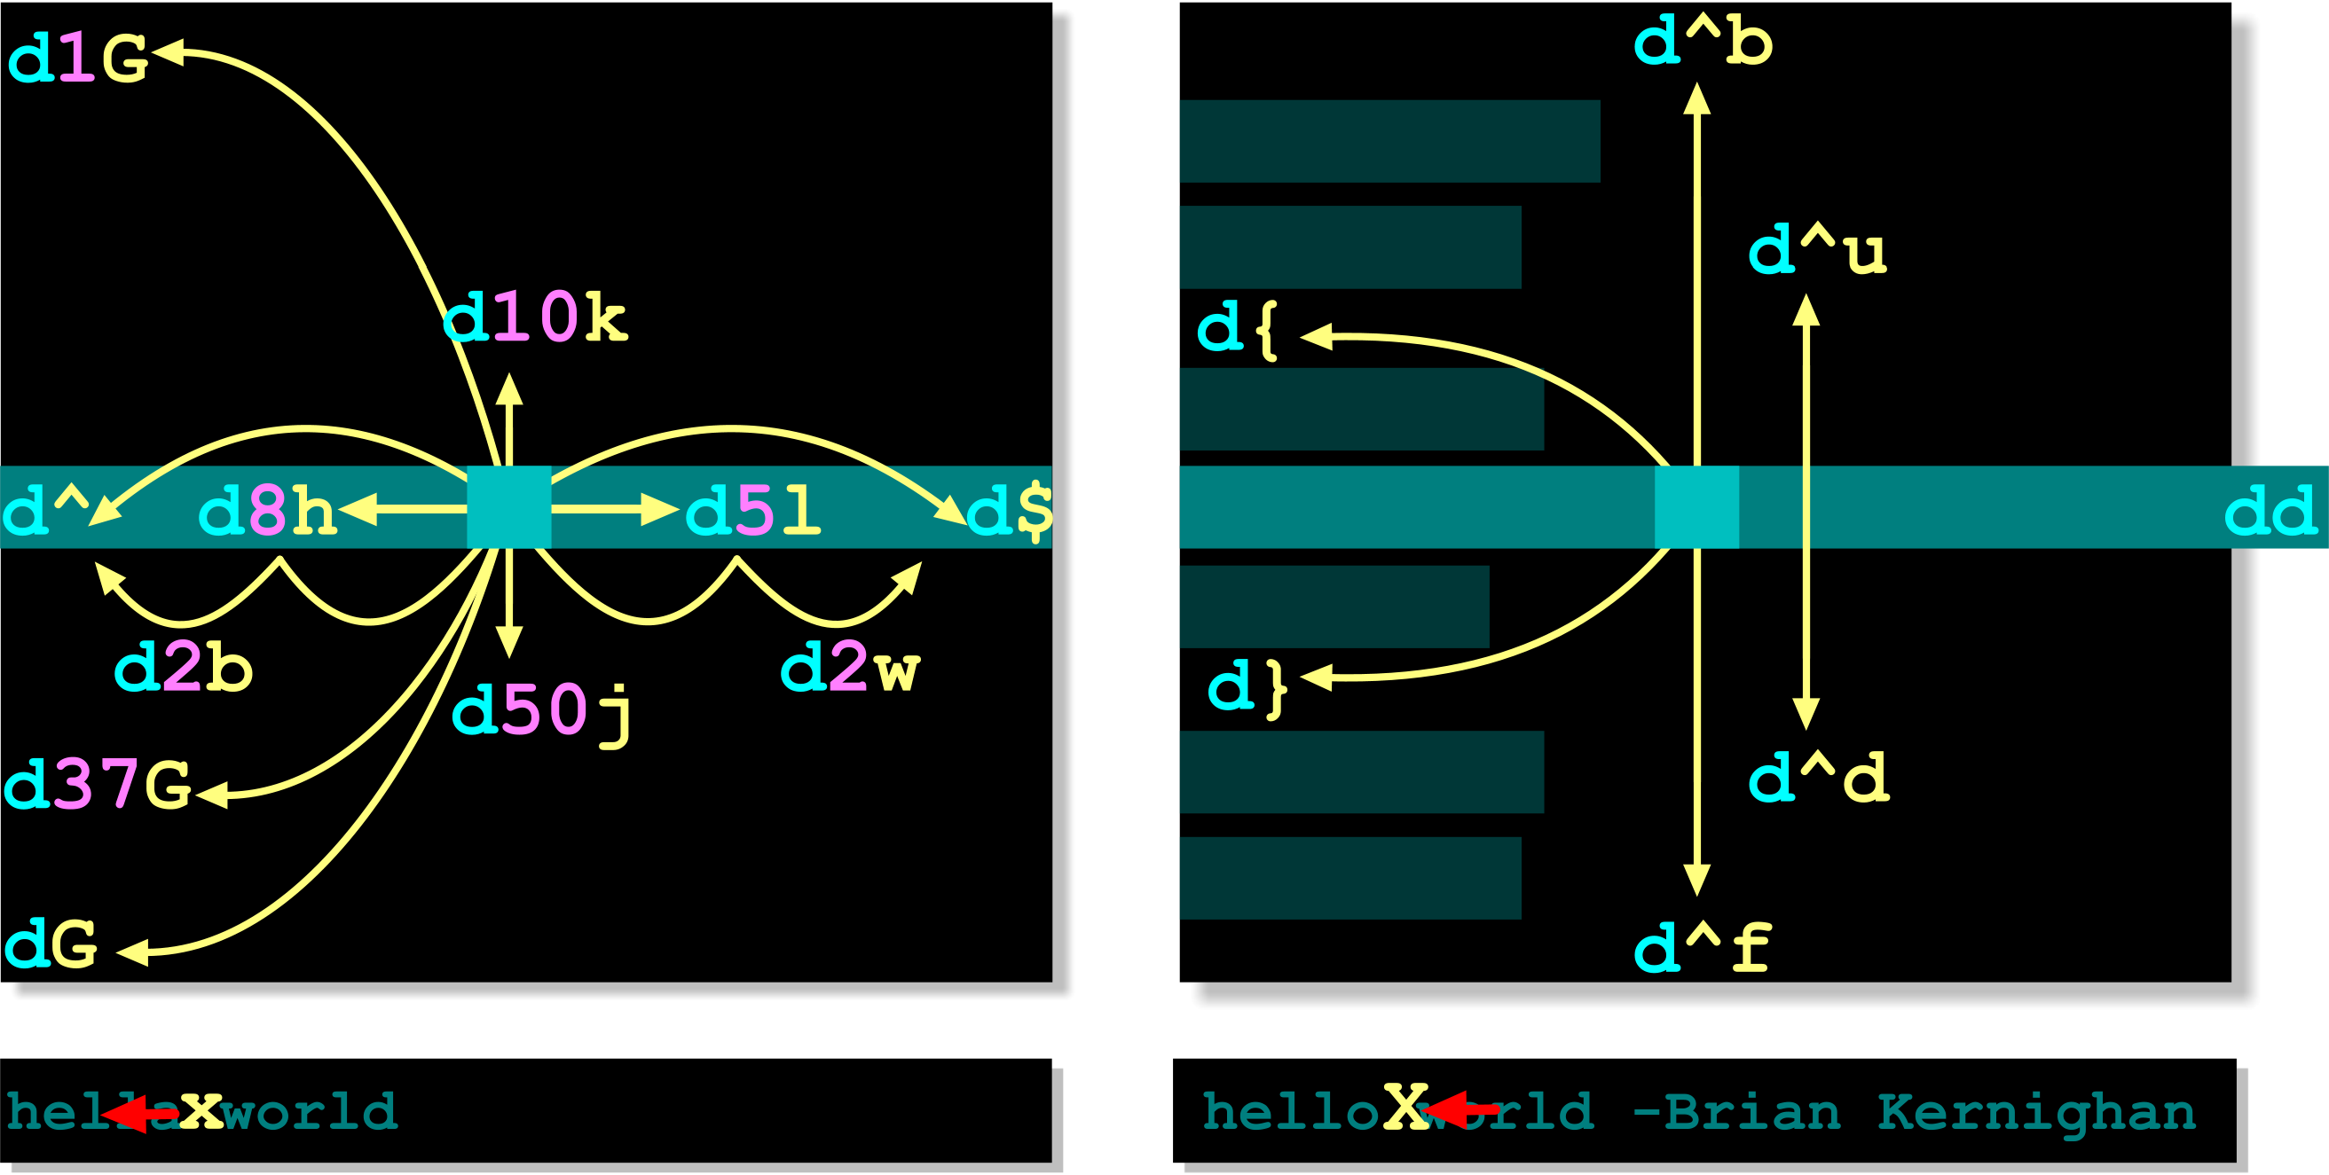
Deleting Text
Your instructor will guide you through these actions:
d<navigation>
Notes:
In Vim, deleting text is done using the d (delete) command, which works in combination with movement commands to define what should be removed. This follows the same pattern as navigation and changing text, command plus movement. For example, dw deletes a word, d$ deletes from the cursor to the end of the line, and dd deletes the entire current line.
You can also use numbers to extend the scope of deletion. For example, d5l deletes five characters, d2w deletes two words, and d10k deletes multiple lines above the cursor. Larger movements such as { and } can be used to delete entire paragraphs, and screen-based movements like Ctrl+U and Ctrl+D can delete larger sections of text.
Unlike the c command, which deletes and then enters insert mode, the d command simply removes the text and keeps you in normal mode. This makes it useful when you want to remove content without immediately replacing it.
Deleted text is stored in Vim’s registers (similar to a clipboard), meaning it can be pasted later using commands like p. This makes deletion part of a broader editing workflow rather than just removing text permanently.

Slide 17
Deleting Text - Keystrokes
d<navigation>
Deleting text:
Deleting characters:
Keys | Action
dw | Delete word (cursor to end of word)
ndw | Delete n words
d3l | Delete next 3 characters
d0 | Delete to start of line
d$ or D | Delete to end of line
d1G or dgg | Delete to start of file
dG | Delete to end of file
dd | Delete current line
ndd | Delete n lines
Keys | Action
x | Delete character under cursor
X | Delete character before cursor
Notes:
Deleting text does a cut (as in cut and paste) of the selected characters.
The delete command operates on a so-called “scope”, which describes an object to be operated on.
When doubled up, the d (delete) command applies to whole lines. Thus, dd will delete one line and 10dd will delete 10 lines.
delete saves the removed text in the paste buffer. It can be retrieved by using the p or P commands (providing no other text has been changed).
vi remembers nine deletions, each of which can be brought back individually.

Slide 18
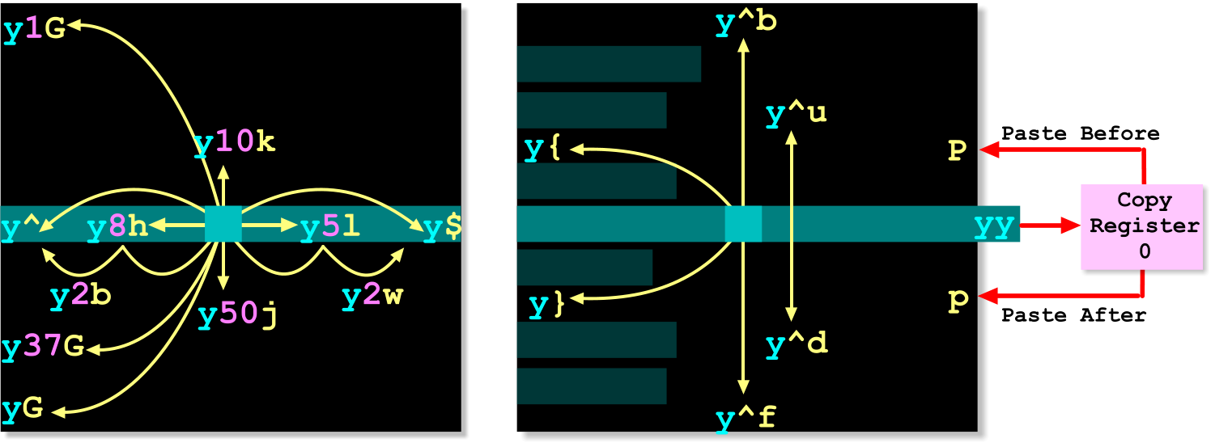
Yank (Copy) and Paste Text
Your instructor will guide you through these actions:
y<navigation>
Notes:
The yank command is Vim's equivalent of copy. Like many Vim commands, it follows the pattern:
y<navigation>
The y command copies text into Vim's unnamed register, while the navigation keystroke determines how much text is copied. For example, yw copies to the end of the current word, y$ copies to the end of the line, and yG copies from the current position to the end of the file.
A special form is yy, which copies the entire current line. Prefixing a count copies multiple lines, for example 5yy copies five lines.
To paste copied text, use p to paste after the current cursor position or P to paste before it. Unlike many GUI editors, Vim stores copied text in registers and allows text to be copied and pasted entirely from the keyboard. The combination of yank, delete, and paste commands makes it easy to reorganise text quickly without leaving Command Mode.
Remember: yank follows the same approach as many Vim commands — the command defines the action, while the navigation keystroke defines the scope of that action.

Slide 19
Yank (Copy) and Paste Text - Keystrokes
y<navigation>
Copying text:
Pasting text:
Keys | Action
yw | Yank to end of word
nyw | Yank to end of nth word
y3l | Yank the next three character
y0 | Yank to the beginning of the line
y$ | Yank to end of the line
y1G or ygg | Yank to the beginning of the file
yG | Yank to end of the file
yy | Yank current line into buffer
nyy | Yank n lines into buffer
Keys | Action
p | Paste current buffer after current position
P | Paste current buffer before current position
Notes:
The y command performs the copy operation, while the navigation keystroke determines how much text is copied. For example, yw copies to the end of the current word, y$ copies to the end of the line, and yG copies from the current position to the end of the file.
The special command yy copies the entire current line. A numeric prefix can be used to copy multiple lines, for example 5yy copies five lines.
To paste copied text, use p to paste after the current cursor position or P to paste before it. These commands allow text to be copied and moved entirely from the keyboard without entering Insert Mode.
Remember: yank uses the same command structure as delete commands, the command (y) defines the action, while the navigation keystroke defines the amount of text affected.

Slide 20
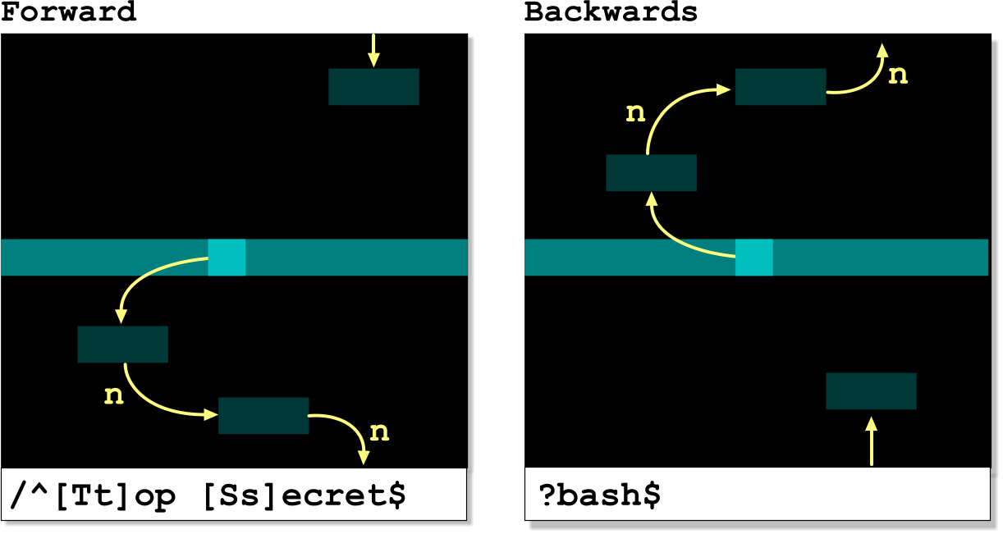
Search for Text
Your instructor will guide you through these actions:
Notes:
Vim provides powerful search capabilities directly from Command Mode. To search forwards through a file, type / followed by the search pattern and press <CR>. To search backwards, use ? followed by the pattern and press <CR>.
After a successful search, press n to move to the next matching occurrence in the same search direction, or N to move to the previous match. Searches can use regular expression patterns, allowing you to search for variations of text rather than exact words.
In the examples shown, /^[Tt]op [Ss]ecret$ searches for lines containing "Top Secret" regardless of capitalisation, while ?bash$ searches backwards for lines ending with the word "bash". Search is one of the most useful navigation features in vim, particularly when working with large configuration files or scripts.

Slide 21
Search for Text - Keystrokes
Searching
Find text quickly within a file
Search forwards or backwards
Jump between matching results
Supports regular expression patterns
Keys | Action
/pattern | Search forward for pattern (regular expression)
?pattern | Search backwards (regular expression)
/ | Repeat last search forwards
? | Repeat last search backwards
n | Repeat last search in same direction (next)
N | Repeat last search in opposite direction (next)
Notes:
This slide summarises the most commonly used search commands in Vim.
Use /pattern to search forwards and ?pattern to search backwards. The search pattern can be plain text or a regular expression.
After a search has been performed, press n to move to the next match in the same direction as the original search, or N to move to the next match in the opposite direction.
These commands are particularly useful when working with large configuration files, scripts and log files where manually navigating through the file would be slow and inefficient.
Tip: Most users only need four commands to search effectively in Vim:
/pattern Search forwards
?pattern Search backwards
n Next match
N Previous match

Slide 22
Marks (Bookmarks)
Create bookmarks and jump quickly around large files
Create named bookmarks within a file
Jump quickly between important locations
Keys | Action
m<letter> | Create a mark at the current line
‘<letter> | Jump to the marked line
d’<letter> | Delete from current position to mark
y’<letter> | Copy (yank) from current position to mark
Notes:
Marks allow you to place named bookmarks within a file and quickly return to important locations later. A mark is created using m followed by a letter, for example ma creates a mark called a at the current line.
To return to a mark, use an apostrophe followed by the mark name, for example 'a. This moves the cursor to the beginning of the line containing that mark.
Marks can also be used as targets for other commands. For example, d'a deletes from the current cursor position to mark a, while y'a copies (yanks) text from the current position to mark a.
Marks are particularly useful when editing large files, allowing you to jump between related sections without repeatedly searching or scrolling. Remember that mark names are case-sensitive, so a and A are treated as different marks.

Slide 23
Common Editing Commands
Useful Editing Commands
Frequently used commands for editing and correcting text
Useful shortcuts that save time when working in Vim
Keys | Action
. | Repeat last editing command
u | Undo last change
U | Undo all changes to current line
J | Join the next line to current line
~ | Toggle character case and move right
yyp or yyP | Duplicate current line
xp | Swap current and next character
ZZ | Save file and exit
Notes:
This slide introduces a selection of useful editing commands that do not fit neatly into the navigation, search or copy-and-paste categories.
The undo commands are particularly important. Press u to undo the most recent change, while U restores the current line to its original state. The . (dot) command is also extremely useful because it repeats the last editing action, saving you from retyping commands.
Other useful commands include J to join lines together, ~ to change the case of a character, and xp to swap two adjacent characters. The yyp command is often used to duplicate lines, while ZZ provides a quick way to save changes and exit Vim without entering Ex Mode.
Tip: Many experienced Vim users rely heavily on just four commands from this slide: ., u, yyp, and ZZ. These alone can significantly speed up everyday editing tasks.

Slide 24
Ex mode
Entering Ex Mode
Ex commands begin with :
The command line appears at the bottom of the screen
Type the command and press <CR> to execute
After execution, Vim returns to Command Mode
Common Uses
Save and quit files (:w, :q, :wq)
Search and replace text
Configure Vim settings (:set number)
Perform commands on specific lines or ranges
Commands operate on the current line unless a range is specified
Notes:
Ex Mode comes from the older ex editor, which was the predecessor to vi. In Vim, Ex Mode is used whenever a command begins with a colon (:).
When you press :, the cursor moves to the command line at the bottom of the screen. You then type a command and press <CR> (Enter) to execute it. Once the command completes, Vim automatically returns to Command Mode.
Ex commands are commonly used for tasks that affect the whole file rather than a small area of text. Examples include saving files (:w), quitting (:q), saving and quitting (:wq), performing search-and-replace operations, and changing editor settings such as displaying line numbers (:set number).
Many Ex commands work on the current line by default, but they can also be applied to a range of lines. This makes Ex Mode particularly useful for file-wide editing and configuration tasks.
Tip: If learners only remember three Ex commands, make them :w, :q, and :wq. These are the commands they will use most often.

Slide 25
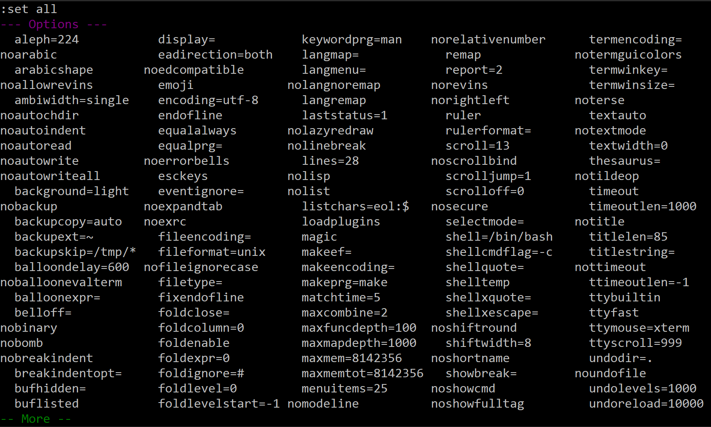

Configuring Vim Options
Most Vim settings follow this pattern:
Turn an option on:
Turn an option off:
:set all
Show all vim settings:
:set showmode
:set noshowmode
Option | Result
:set number | Show line numbers
:set nonumber | Hide line numbers
:set autoindent | Enable auto-indent
:set noautoindent | Disable auto-indent
:set ignorecase | Ignore case when searching
Most Vim options are enabled with :set option and disabled with :set nooption
Notes:
Vim contains many configurable options that control how the editor behaves. These options are managed using Ex Mode commands beginning with :set.
Most Vim settings follow a simple convention. To enable a feature, use :set option. To disable the same feature, use :set nooption. For example, :set number displays line numbers, while :set nonumber hides them again.
The command :set all displays all available Vim options and their current values. Because there are many settings, the output is paged and can be exited by pressing q.
Some options are useful when editing scripts and configuration files. For example, :set autoindent helps maintain indentation, while :set ignorecase makes text searches case-insensitive.
For a fundamentals course, the most useful option to remember is :set number, as line numbers make navigating and discussing files much easier.

Slide 26
Applying Commands to Specific Lines/Ranges
Single line addressing:
Range addressing:
Ex command | Action
:command | Execute to current line
:ncommand | Execute to line n
:1command | Execute to first line
:$command | Execute to last line
Ex command | Action
:n,mcommand | Execute on lines n to m (inclusively)
:1,$command | Execute on all lines
:/RE1/,/RE2/command | Execute on matching range
By default, Ex commands operate on current line unless specified
Notes:
By default, Ex commands operate on the current line. However, Vim allows commands to be directed at a specific line or a range of lines by placing an address before the command.
Single-line addressing uses a line number. For example, :1command executes the command on the first line of the file, while :$command executes it on the last line. A specific line number can also be used, such as :25command.
Ranges are specified using two addresses separated by a comma. For example, :10,20command executes the command on lines 10 through 20 inclusive. The range :1,$command applies the command to every line in the file.
Vim can also use search patterns as addresses. The command :/RE1/,/RE2/command applies the command to all lines between the first line matching RE1 and the next line matching RE2.
Understanding line addressing is important because many powerful Ex commands, particularly search-and-replace operations, can be restricted to selected sections of a file rather than affecting the entire document.

Slide 27
Search and Replace Text
:[range]s/search/replace/[flags]
Command Syntax
Flags:
Examples:
Flags | Meaning
g | Replace all matches
c | Confirm each replacement
i | Ignore case when searching
Ex command | Result
:s/old/new/ | Replace first match on current line
:s/old/new/g | Replace all matches on current line
:1,$s/old/new/g | Replace all matches in entire file
:1,$s/old/new/gc | Replace all matches in entire file, confirming each change
:14,20s/old/new/gc | Replace all matches between lines 14 and 20, confirming each change
Notes:
The s command performs search-and-replace operations in Ex mode. The general syntax is::
[range]s/search/replace/[flags]
If no range is specified, the command applies to the current line. A range can be a line number range such as 14,20, the entire file using 1,$, or lines selected using search patterns.
The g flag replaces all matching occurrences on each line, while the c flag asks for confirmation before making each change.
For most day-to-day editing, the commands learners are most likely to use are:
:s/old/new/
:1,$s/old/new/g
:1,$s/old/new/gc
These cover replacing text on the current line, throughout the file, and throughout the file with confirmation.

Slide 28

Reading Files and Command Output
Ex mode can:
Read the contents of files into the current document
Execute shell commands and insert their output into the current document
Command | Example
:r file | :r /etc/hostname
:!command | :!date
:r!command | :r !date
:!command displays output. :r !command inserts output into the file.
Notes:
The :r command reads external content into the current document. When used with a filename, the contents of the file are inserted after the current line.
The :! command temporarily runs a shell command and displays its output. After reviewing the output, press <Enter> to return to Vim.
Combining the two commands allows the output of a shell command to be inserted directly into the file. For example, :r !date inserts the current date and time into the document.
This feature is useful for importing file contents or command output without leaving the editor.

Slide 29
Writing and Exiting Vim
Ex commands can:
Save changes to a file
Save using a different filename
Write selected lines to another file
Exit Vim, with or without saving changes
Command | Action
:w | Save changes to the current file
:w! | Force save, overriding write protection where permitted
:w file | Save a copy using a new filename
:10,20w data.txt | Write lines 10 to 20 to file summary.txt
:q | Quit if no unsaved changes exist
:q! | Quit and discard changes
:wq | Save and quite
ZZ | Save and quit (Command mode)
The most common commands are :wq and :q!
Notes:
Ex mode commands provide a convenient way to save files and leave Vim. They are entered by pressing : from Command Mode, followed by the required command.
The most commonly used command is :wq, which saves any changes and exits the editor. If you decide not to keep your changes, :q! discards them and quits immediately. A normal :q only works if the file has not been modified since the last save.
Ex commands can also save content in different ways. For example, :w file creates a copy of the current file using a new filename, while commands such as :10,20w data.txt write a selected range of lines to another file. This can be useful when extracting part of a configuration file, script or document.
Although several save-and-exit commands exist, most users rely on just three:
:wq Save and quit
:q! Quit without saving
:q Quit
Experienced Vim users may also use ZZ from Command Mode, which saves changes (if required) and exits without entering Ex mode.

Slide 30
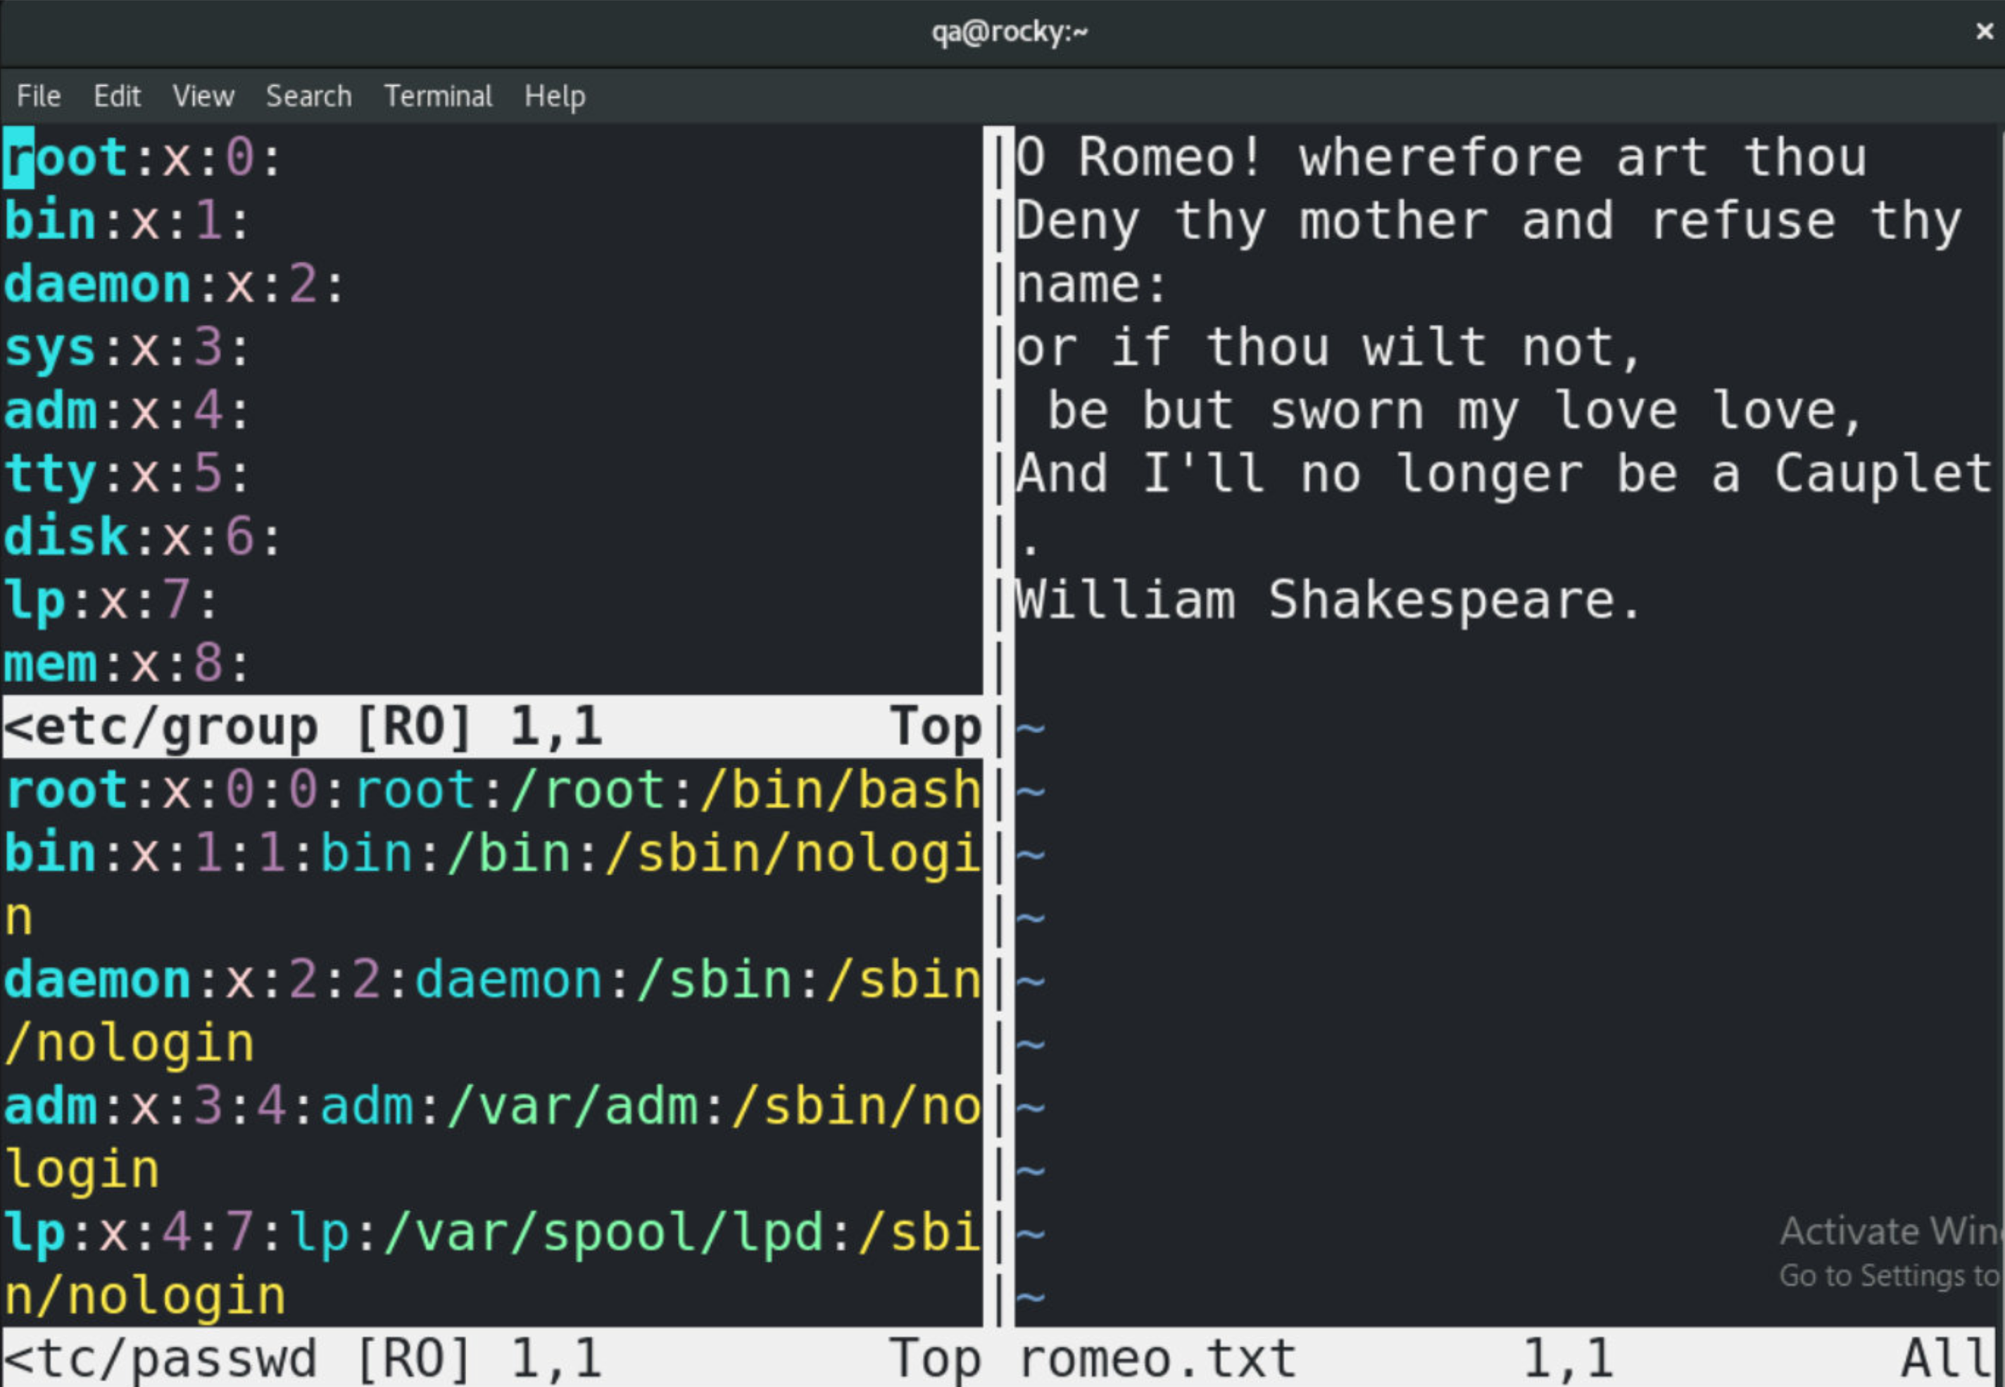
Working with Multiple Windows
Vim can display multiple editing windows at the same time
Compare different files side-by-side
View different parts of the same file simultaneously
Horizontal and vertical splits are supported
Move between windows using keyboard commands
Command | Action
:split [file] | Split the screen horizontally
:vsplit [file] | Split the screen vertically
Ctrl+w [hjkl] | Move window left, down, up, right
Window splitting is useful when comparing configuration files or copying text between files.
Notes:
Vim supports multiple editing windows within a single editing session. This allows users to work with more than one file at a time, or view different parts of the same file simultaneously.
The :split command divides the screen into horizontal windows, while :vsplit creates vertical windows. A filename can optionally be specified to open a different file in the new window.
Once multiple windows are open, use Ctrl+w followed by a direction key (h, j, k, or l) to move between windows. These correspond to left, down, up, and right respectively.
Window splitting is particularly useful when comparing configuration files, reviewing changes, copying information between files, or viewing different sections of a large document.
This is one of Vim's most powerful productivity features and demonstrates how multiple files can be managed without leaving the editor or opening additional terminal sessions.

Slide 31
Practical exercise 4 – vi
In the accompanying Exercise Guide

Slide 32
Using nano
If Vim feels too much for occasional editing, Nano provides a simpler alternative

Slide 33
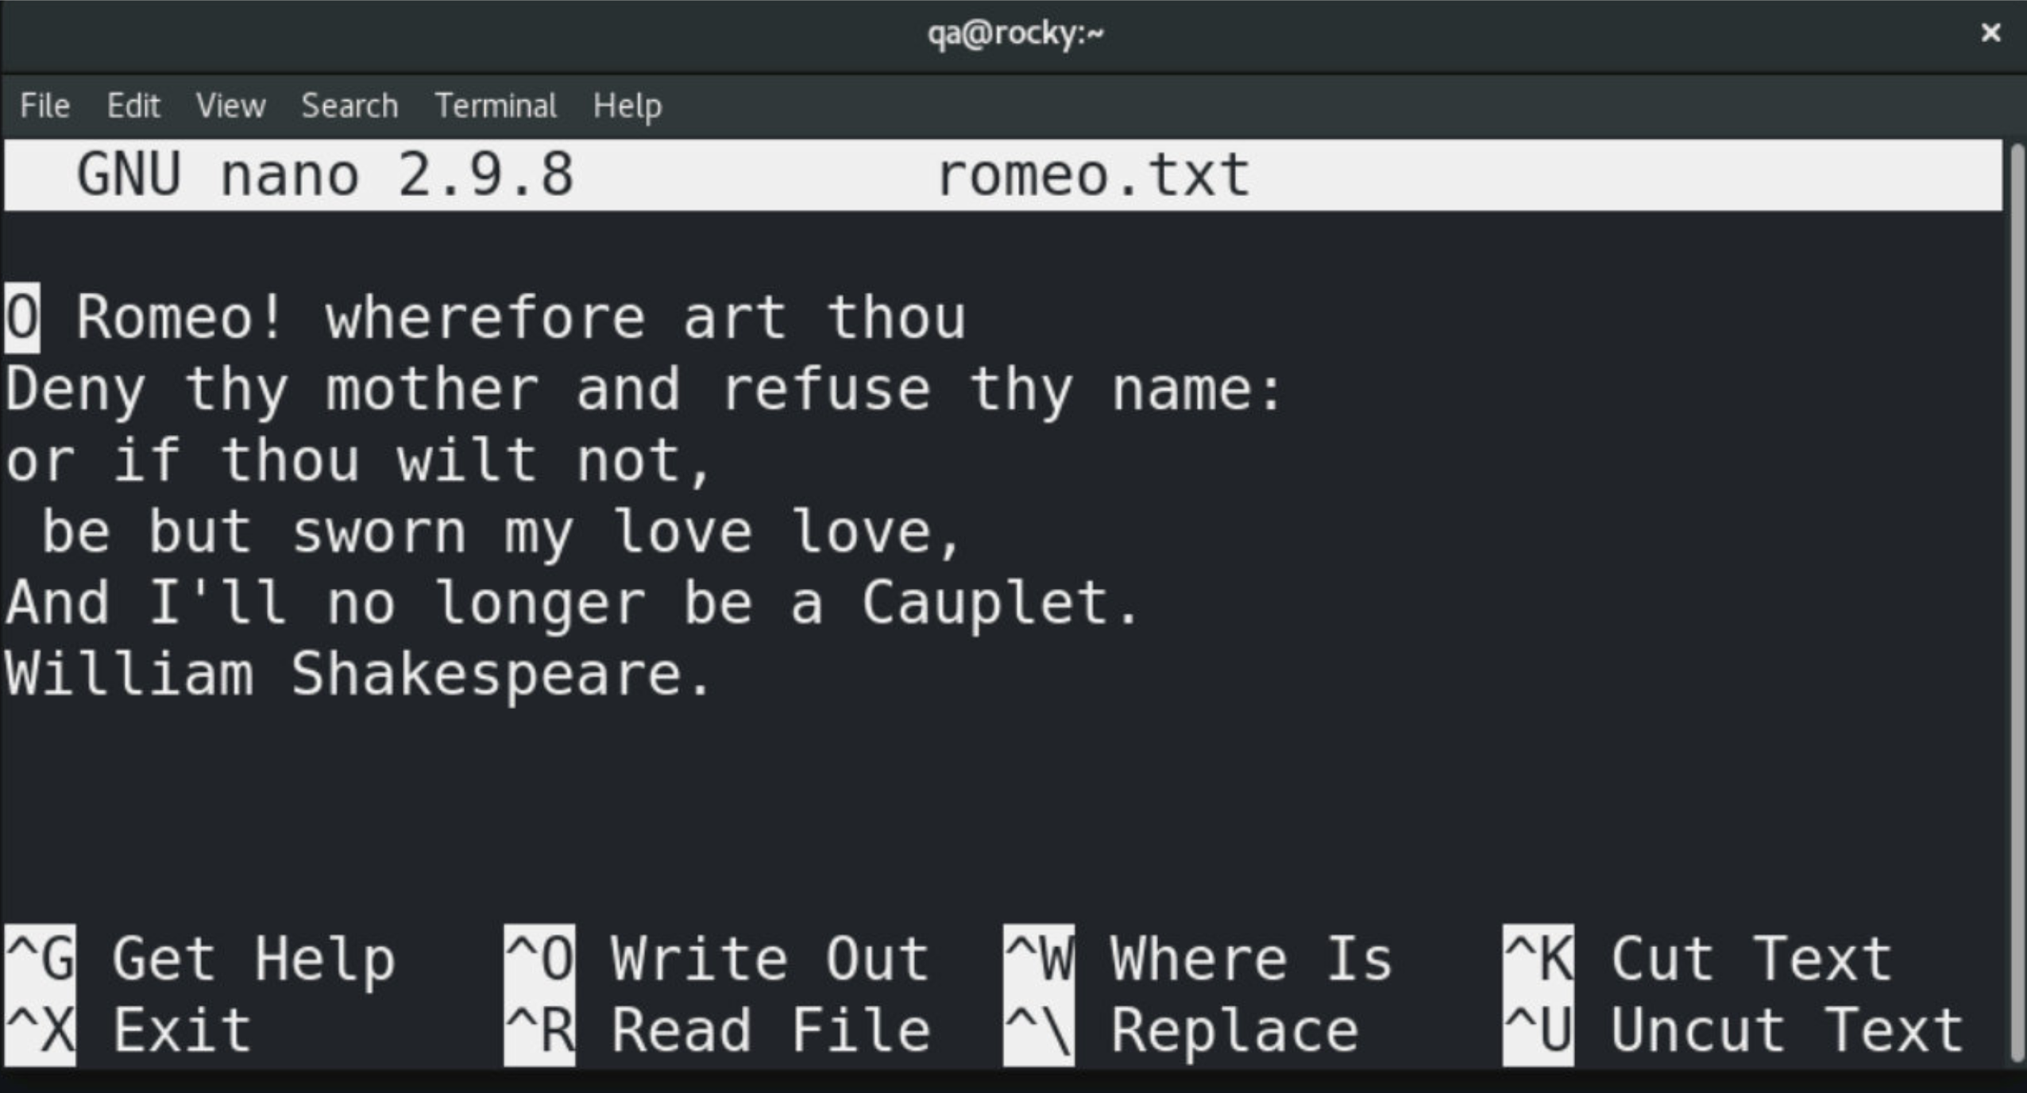
Nano: A Simple Terminal Text Editor
Easier to learn than Vim
Displays common commands at the bottom of the screen
Uses Ctrl-key shortcuts rather than modes
Suitable for quick file edits and configuration changes
Start Nano with:
$ nano romeo.txt
Edit space – arrow keys and backspace keys work
Editor control keys
Only ONE you need to learn!
Notes:
Nano is a simple terminal-based text editor that is designed to be easy to learn and use. Unlike Vim, Nano does not have separate command and insert modes. As soon as the editor opens, you can begin typing and editing text immediately.
One of Nano's most useful features for beginners is that the most common commands are displayed at the bottom of the screen. Commands are activated using the Ctrl key, shown as the ^ symbol in the menu. For example, ^X means Ctrl+X. To edit a file, simply start Nano followed by a filename: nano romeo.txt
If the file exists, Nano opens it for editing. If the file does not exist, Nano creates a new file when it is saved. Standard editing keys such as the arrow keys, Backspace, Delete, Home and End work as expected, making Nano feel familiar to users coming from Windows editors such as Notepad. For many Linux administrators, Nano is the preferred editor for quick configuration changes because it requires very little knowledge to get started. While Vim offers far more advanced editing capabilities, Nano is often the easiest way to make simple changes to files.
Tip: If you only remember one Nano command, remember Ctrl+X. It exits Nano and will automatically prompt you to save any unsaved changes. This is often all a new user needs to get started.

Slide 34
Navigation and Searching in Nano
Most navigation keys work as expected (Arrow keys, Home, End, Page Up, Page Down)
Additional shortcuts are available using the Ctrl key
Search for text or jump directly to a specific line
Nano displays available shortcuts at the bottom of the screen
Shortcut | Action
Ctrl+C | Show current line and column
Ctrl+A | Move to start of line
Ctrl+E | Move to end of line
Ctrl+_ | Go to line and column
Ctrl+W | Search for text
Ctrl+Y | Previous page
Ctrl+V | Next page
Most users only need Ctrl+W (search) and Ctrl+_ (goto line).
Notes:
Nano behaves much like a traditional text editor, so the arrow keys, Home, End, Page Up and Page Down keys can be used for most navigation tasks.
Additional shortcuts are available using the Ctrl key. The most useful are Ctrl+W to search for text and Ctrl+_ to jump directly to a specific line number. These are particularly helpful when working with larger configuration files or scripts.
Ctrl+C displays the current cursor position, including the line and column number. This can be useful when following troubleshooting instructions that reference specific lines within a file.
Unlike Vim, Nano does not require users to remember different modes or complex navigation commands. Most users can become productive with Nano after learning only a handful of keyboard shortcuts.

Slide 35
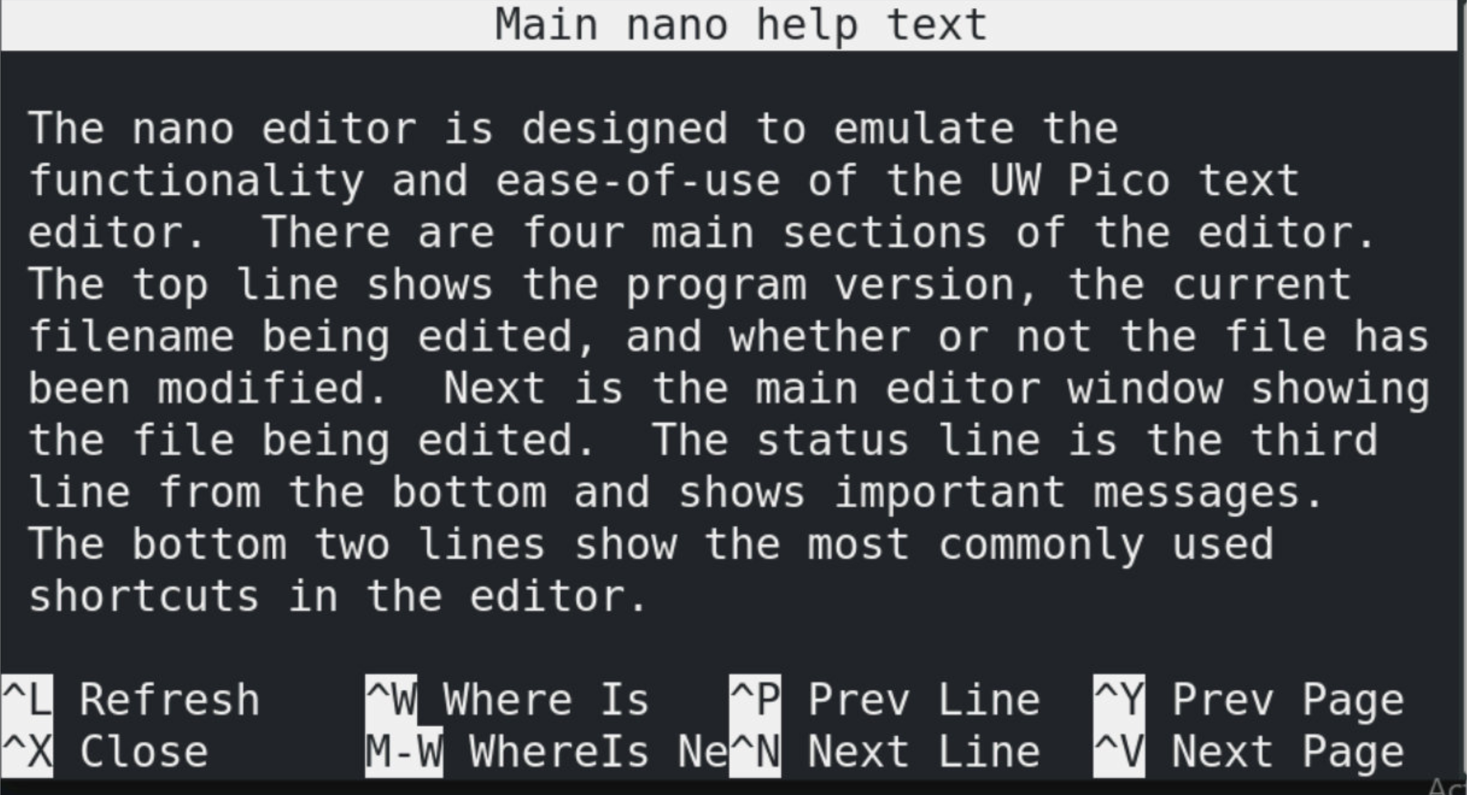
Cutting and Pasting Text in Nano
Ctrl+K cuts the current line
Ctrl+U pastes the previously cut text
Multiple lines can be cut by pressing Ctrl+K repeatedly
Cut text is stored in a temporary buffer until it is pasted
Getting Help in Nano:
Press Ctrl+G to display Nano's built-in help.
Shortcut | Action
Ctrl+K | Cut current line
Ctrl+U | Paste cut text
Alt+A | Mark text for selection
Ctrl+6 | Alternative mark command
Ctrl+K and Ctrl+U are often enough for quick configuration changes.
Notes:
Nano provides a simple cut-and-paste mechanism using keyboard shortcuts. Pressing Ctrl+K removes the current line and stores it in Nano's cut buffer. Pressing Ctrl+U pastes the stored text at the current cursor position.
Unlike graphical editors, Nano does not require a mouse for basic editing tasks. Repeatedly pressing Ctrl+K allows multiple consecutive lines to be cut and then pasted together elsewhere in the file.
For most administration work, Ctrl+K and Ctrl+U are sufficient for moving configuration entries or reorganising text. More advanced text selection features exist but are rarely required for everyday Linux administration.

Slide 36
Editing, Saving and Exiting
Type directly into the document to insert text
Use Backspace and Delete to remove text
Save changes using Ctrl+O (Write Out)
Exit Nano using Ctrl+X
Nano prompts before discarding unsaved changes
Shortcut | Action
Ctrl+O | Save (Write Out)
Ctrl+X | Exit Nano
Ctrl+K | Cut current line
Ctrl+U | Paste previously cut text
Ctrl+\ | Search and replace text
Nano displays these commands at the bottom of the screen while editing.
Notes:
Nano is designed to be simple and approachable. Unlike Vim, there are no modes to remember; you can begin typing immediately when the editor opens.
For most day-to-day administration tasks, only two commands are essential:
Ctrl+O saves the file (Write Out)
Ctrl+X exits Nano
If changes have not been saved, Nano will prompt you before exiting, helping prevent accidental data loss.
Nano also provides a few useful editing shortcuts. Ctrl+K cuts the current line and Ctrl+U pastes previously cut text, making it easy to move configuration entries or blocks of text. Ctrl+\ performs search and replace operations within the file.
One of Nano's biggest advantages for new Linux users is that the available commands are displayed at the bottom of the screen at all times, providing a built-in reminder of the most common shortcuts.

Slide 37
Choosing an Editor
There is no "best" editor. Use the one that allows you to work efficiently.
Editor | Best For
Nano | Quick edits, beginners
Vim | Administration, remote systems, advanced editing
Graphical editor (gedit, Kate) | Desktop Linux environments
Notes:
Linux provides a wide range of text editors, each designed for different styles of working. During this module, we focused on Vim and Nano because they are commonly available on Linux systems and can be used directly from a terminal session.
Nano is generally easier for new users to learn. It provides on-screen reminders of common commands and is well suited to quick configuration changes or occasional file editing.
Vim has a steeper learning curve but offers powerful editing, navigation and automation features. It is widely used by system administrators and is particularly useful when working remotely over SSH, where graphical tools may not be available.
Desktop Linux environments often provide graphical editors such as gedit or Kate. These work much like editors found on Windows and can be convenient when working in a graphical session.
There is no universally "best" editor. The most important factor is choosing a tool that allows you to work efficiently and confidently. Many experienced Linux users know both Nano and Vim, using Nano for quick changes and Vim when more advanced editing capabilities are required.

Slide 38
Practical Exercise 4 – nano
In the accompanying Exercise Guide

Slide 39
Summary
In this module you learned how to:
Use Vim
Open, create and edit files
Navigate using keyboard commands
Insert, change, delete, copy and paste text
Search, replace, save and exit files
Use Nano
Edit files using simple keyboard shortcuts
Search, cut, paste, save and exit files
Work with Editors
Work with multiple Vim windows
Choose the right editor for the task

